Slide 1


23CS1512
SOCIALLY RELEVANT MINI PROJECT

Slide 2


AUTISM PREDICTION USING DEEP LEARNING
TEAM MEMBERS : TAMILARASI S(211423104679)
THARUNI R (211423104692)
DEPARTMENT : COMPUTER SCIENCE AND ENGINEERING
GUIDE NAME : DR. SATHIYA V
CO-ORDINATORS : DR. SUBEDHA V, MRS. S SHARMILA
DOMAIN : DEEP LEARNING
TEAM NUMBER : 05

Slide 3
ABSTRACT
Autism Spectrum Disorder (ASD) is often diagnosed late because current methods depend on expert observation and long assessment processes. This delay makes it harder for children to get timely support and therapy. To solve this problem, our project aims to build an automated system that can help in the early detection of ASD using videos uploaded by users. The main objective is to create a tool that is simple, non-invasive, and reliable so that families and healthcare professionals can use it for quick screening.

Slide 4
ABSTRACT
Our method uses deep learning: Convolutional Neural Networks (CNNs) capture facial features and behaviors such as eye contact, expressions, and repetitive movements, while Long Short-Term Memory (LSTM) networks study how these behaviors change over time. By combining these techniques, the system can identify patterns linked to ASD and provide an accurate prediction. This approach has the potential to make early ASD screening more accessible and effective.

Slide 5
INTRODUCTION
Autism Spectrum Disorder (ASD) affects communication, behavior, and social interaction.
Early detection is critical but often delayed due to subjective assessments.
This project uses deep learning to analyze user-uploaded videos, identifying behavioral and facial cues for faster, more reliable ASD screening.

Slide 6

OBJECTIVES
To develop an AI-based system for predicting Autism Spectrum Disorder (ASD) using video input.
To extract facial and behavioral features using Convolutional Neural Networks (CNNs).
To analyze time-based behavioral patterns with Long Short-
Term Memory (LSTM) networks.
To build a non-invasive, automated tool that supports early ASD screening.
To evaluate the model’s accuracy and reliability using real- world video data.

Slide 7
PROBLEM STATEMENT
Social Problem:
Lack of accessible and early autism screening tools leads to delayed diagnosis and intervention.
Who is affected?
Children with undiagnosed ASD, especially in rural or underserved
areas, miss out on early support.
Parents, teachers, and healthcare providers struggle without accessible screening tools.
Data:
Over 1 in 100 children globally are diagnosed with ASD, yet many cases remain undetected due to limited access to early screening tools.

Slide 8
PROBLEM:
Traditional ASD diagnosis is time-consuming, expert-dependent, and not easily accessible, leading to delayed intervention and support.
SDG GOAL:
SDG 3 – Good Health and Well-being: Ensure healthy lives and promote well-being for all..
MAPPED SDG GOAL(S):
SDG 3:
Good Health and Well-being
TARGET 16.4:
Achieve universal health coverage, including access to quality essential healthcare services and early diagnosis by 2030.

Slide 9


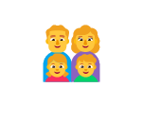
PROPOSED SOLUTION
We propose an intelligent Deep Learning–based ASD Prediction System that analyzes user-uploaded videos to detect early signs of autism in a non-invasive, automated way.
What Is Innovative or Impactful About It?
Video-based analysis using deep learning (CNN + LSTM) for autism detection.
Fast, non-invasive, and accessible screening from home.
Supports early diagnosis, reaching underserved users and improving outcomes.

Slide 10



TOOLS AND TECHNOLOGY USED
Data Collection – Python, OpenCV
Data Processing – Pandas, NumPy, OpenCV
Deep Learning Models – TensorFlow, Keras (CNN, LSTM)
Visualization – Matplotlib, Seaborn
Version Control – Git, GitHub

Slide 11
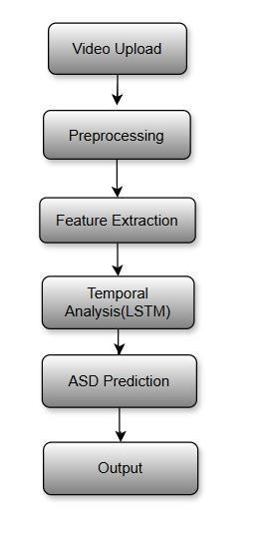





IMPLEMENTATION PLAN
WorkFlow

Slide 12

HARDWARE REQUIREMENTS
Hardware Requirements:
Processor: Intel i5 or higher / Apple M1/M2
RAM: Minimum 8 GB (Recommended: 12–16 GB for smoother processing)
Storage: Minimum 20 GB free disk space
Camera: (Optional) for future real-time input or data collection

Slide 13
SOFTWARE REQUIREMENTS
Operating System: Windows 10/11
Programming Language: Python 3.x
Libraries & Frameworks:
TensorFlow / Keras (with CPU support)
OpenCV (for video and image processing) NumPy, Pandas (data handling) Matplotlib, Seaborn (for visualization)
Development Tools:
Jupyter Notebook / Visual Studio Code
Git & GitHub (for version control and collaboration)

Slide 14
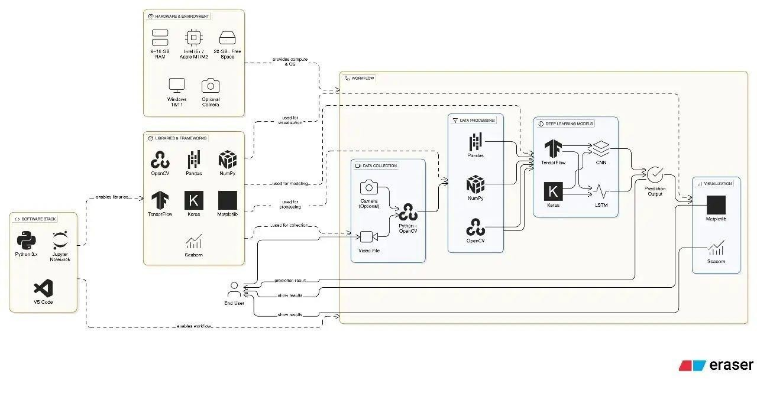
SYSTEM ARCHITECTURE

Slide 15
MODULE EXPLANATION
The system captures video input using a camera or uploaded file and processes it with OpenCV.
Frames are extracted and preprocessed using NumPy and Pandas.
CNN extracts spatial facial features, while LSTM learns behavioral patterns over time.
The model, built with TensorFlow and Keras, predicts ASD Likelihood.
Results are visualized using Matplotlib and Seaborn for analysis and interpretation.

Slide 16
LITERATURE SURVEY
S.No | Title | Author(s) | Journal/Conference | Year | Publisher | Technique Used
1 | Transformer-based Deep Learning for Autism Detection from Health Data | Kevin Dick et al. | IEEE Journal of Biomedical and Health Informatics | 2024 | IEEE | Transformer-based ensemble
2 | Explainable AI for Autism Prediction using EEG | P. Patel et al. | IEEE EMBC | 2023 | IEEE | CNN + SHAP
3 | Autism Spectrum Disorder Detection using Eye-Tracking and Vision Transformer | Wafaa Kasri et al. | IEEE BIBM | 2024 | IEEE | Vision Transformer
4 | Graph-Based Deep Learning for Autism Detection | Yicheng Leng et al. | IEEE Transactions on Medical Imaging | 2025 | IEEE | Graph Transformer
5 | Early ASD Detection using Deep CNNs on Facial Images | Serna-Aguilera et al. | IEEE CVPR Workshops | 2024 | IEEE | Deep CNN

Slide 17
LITERATURE SURVEY
S.No | Title | Author(s) | Journal/Conference | Year | Publisher | Technique Used
6 | Autism Detection Using Audio Signals with CNN-LSTM | Rana et al. | IEEE SLT Workshop | 2023 | IEEE | CNN + LSTM
7 | Deep Neural Networks for Early Autism Detection | I. R. Tan et al. | IEEE Big Data | 2023 | IEEE | DNN, audio+video fusion
8 | Detection of Autism Using Machine Learning Algorithms | M. Maheswari et al. | AIP Conf. Proc. (IEEE-style) | 2023 | AIP | Random Forest, SVM
9 | Autism Classification using Functional MRI and Deep Autoencoders | J. Zhang et al. | Neurocomputing | 2023 | Elsevier | Autoencoder
10 | Deep Learning Approach for Autism Detection from Facial Images | A. Singh et al. | Computers in Biology and Medicine | 2024 | Elsevier | CNN, Transfer Learning

Slide 18
LITERATURE SURVEY
S.No | Title | Author(s) | Journal/Conference | Year | Publisher | Technique Used
11 | Ensemble Deep Learning Model for ASD Prediction | R. Kumar et al. | BMC Psychiatry | 2023 | Springer Nature | Ensemble CNN
12 | fMRI-based Prediction of ASD Using 3D CNN | X. Wang et al. | Scientific Reports | 2023 | Nature | 3D-CNN
13 | Autism Spectrum Disorder Prediction Using Facial Landmarks | A. Sharma et al. | Cognitive Systems Research | 2024 | Elsevier | CNN, Landmark detection
14 | Deep Learning Framework for ASD from Behavioral Data | T. N. Lee et al. | PLOS ONE | 2024 | PLOS | RNN on behavior scores
15 | Multimodal Deep Learning for Early ASD Detection | R. Bhatt et al. | Journal of Neuroscience Methods | 2024 | Elsevier | Multimodal CNN-RNN

Slide 19
BASE PAPER DETAILS
Title: Transformer-based Deep Learning for Autism Detection from Health Data
Author(s): Kevin Dick et al.
Journal/Conference: IEEE Journal of Biomedical and Health Informatics
Year: 2024
Publisher: IEEE
Title: Explainable AI for Autism Prediction using EEG
Author(s): P. Patel et al. Journal/Conference: IEEE EMBC Year: 2023
Publisher: IEEE

Slide 20
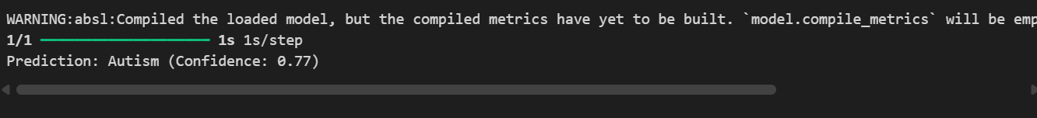
OUTPUT SCREENSHOT:

Slide 21
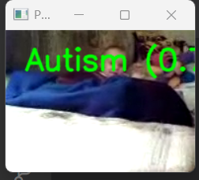
VIDEO POPUP SCREENSHOT:

Slide 22
TARGET USERS & IMPACT
WHO BENEFITS FROM THE PROJECT?
Children with ASD, parents, caregivers, educators, and healthcare professionals benefit through early, accessible screening.
HOW MANY USERS?
Globally, over 75 million people are affected by ASD, with millions more undiagnosed, especially in low-resource areas.
WHAT SOCIAL OUTCOMES ARE EXPECTED?
- Enables early detection of autism, leading to timely support and
intervention.
Improves access to screening, especially in remote or underserved areas.
Promotes awareness and reduces stigma around ASD in society.

Slide 23
FUTURE SCOPE / VISION
LONG-TERM IDEA BEYOND MVP:
Build a scalable autism screening platform integrated with healthcare and education systems, using real-world video data for continuous model improvement.
POSSIBLE COLLABORATIONS:
Collaborate with hospitals, autism NGOs, government health programs, and EdTech platforms to enable wide deployment and awareness.

Slide 24
REFERENCES
Base paper:
1) AI based Classification for Autism Spectrum Disorder Detection using Video Analysis. (2022, December 8). IEEE Conference Publication | IEEE Xplore. https://ieeexplore.ieee.org/document/10037438
2) Multimodal Deep Learning Framework for Non-Intrusive Autism Spectrum Disorder Detection. (2025, February 11). IEEE Conference Publication | IEEE Xplore. https://ieeexplore.ieee.org/document/10940187
3) Activity-based early autism diagnosis using a Multi-Dataset supervised contrastive learning approach. (2024, January 3). IEEE Conference Publication | IEEE Xplore. https://ieeexplore.ieee.org/document/10484184
4) Deep Learning for Early Autism Screening: Analysis of Hand-Flapping Motions in Infants. (2024, December 12). IEEE Conference Publication | IEEE Xplore. https://ieeexplore.ieee.org/document/10851000
5) A revolutionizing deep sign language prediction for autism spectrum disorder using hybrid deep learning algorithm and computer vision. (2025, April 16). IEEE Conference Publication | IEEE Xplore. https://ieeexplore.ieee.org/document/11019248
6) Sze, V., Chen, Y., Yang, T., & Emer, J. S. (2017). Efficient Processing of deep Neural Networks: A tutorial and survey. Proceedings of the IEEE, 105(12), 2295–2329. https://doi.org/10.1109/jproc.2017.2761740
7) Leveraging Light GBM, MLP, and Extra Tree classifiers for early detection and prediction of autism spectrum disorder. (2024, September 20). IEEE Conference Publication | IEEE Xplore. https://ieeexplore.ieee.org/document/10779640

Slide 25
REFERENCES
9) Autism Prediction using ML Algorithms. (2022, November 9). IEEE Conference Publication | IEEE Xplore. https://ieeexplore.ieee.org/document/10040300
10) Enhancing early autism prediction using machine learning techniques. (2025, April 2). IEEE Conference Publication | IEEE Xplore. https://ieeexplore.ieee.org/document/11115668
11) Autism screening prediction based on multi-kernel support vector machine. (2023, October 18). IEEE Conference Publication | IEEE Xplore. https://ieeexplore.ieee.org/document/10420224
12) Prediction of Autism Spectrum Disorder in Children using Face Recognition. (2021, October 7). IEEE Conference Publication | IEEE Xplore. https://ieeexplore.ieee.org/document/9591679
13) A Comparative Analysis of Prediction of Autism Spectrum Disorder (ASD) using Machine Learning. (2022, April 28). IEEE Conference Publication | IEEE Xplore. https://ieeexplore.ieee.org/document/9777240
14) A machine learning approach to predict autism spectrum Disorder. (2019, February 1). IEEE Conference Publication | IEEE Xplore. https://ieeexplore.ieee.org/document/8679454
15) Utilizing Machine Learning and employing the XGBoost Classification Technique for evaluating the likelihood of Autism Spectrum Disorder (ASD). (2024, May 24). IEEE Conference Publication | IEEE Xplore. https://ieeexplore.ieee.org/document/10593455
Github:
https://github.com/saadhaxxan/Autism-spectrum-disorder-Detection- using-Deep-Learning

